Slide 1
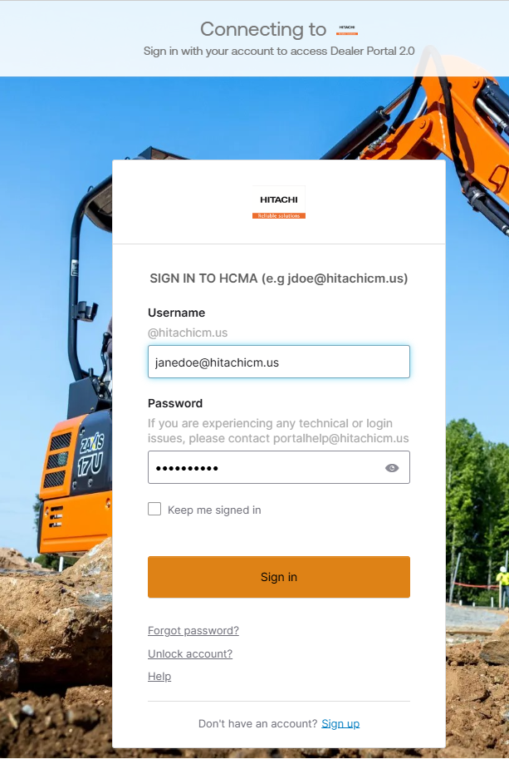
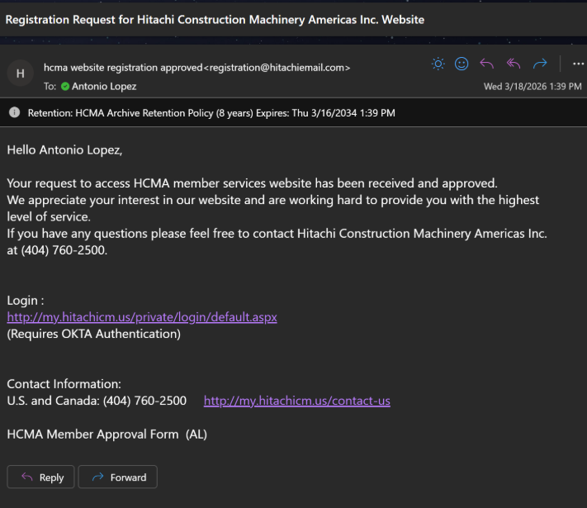
Accessing dealer Portal 2.0
*Follow these steps after you have received a confirmation email from Hitachi/Landcros confirming your access has been granted.
To Access Dealer portal 2.0, use the link https://dealerportal.hitachicm.us to be sent to the login page. Our application authenticator will ask for your login credentials or give you the option to create an account. If you have logged into Dealer Portal previously, simply enter your username (email address) and password. If you have never accessed Dealer portal 2.0 , click on the blue Sign up link

Slide 2
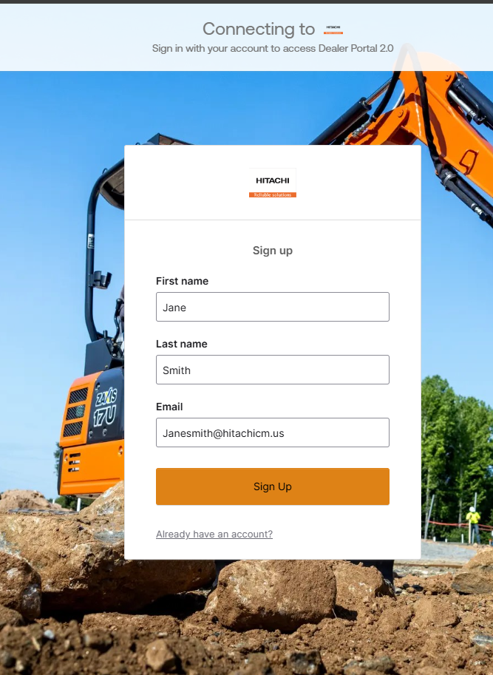
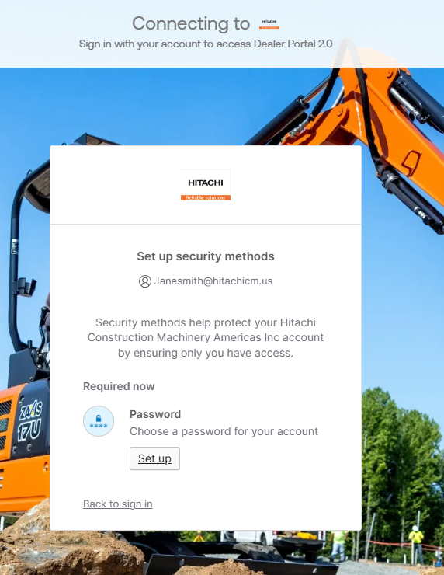
Accessing Dealer Portal 2.0
Enter your Name, and corporate email address, then click Sign Up to create your account.
Upon your first time accessing the Dealer portal, you will be asked to setup security methods to secure your account. (chose 2)

Slide 3
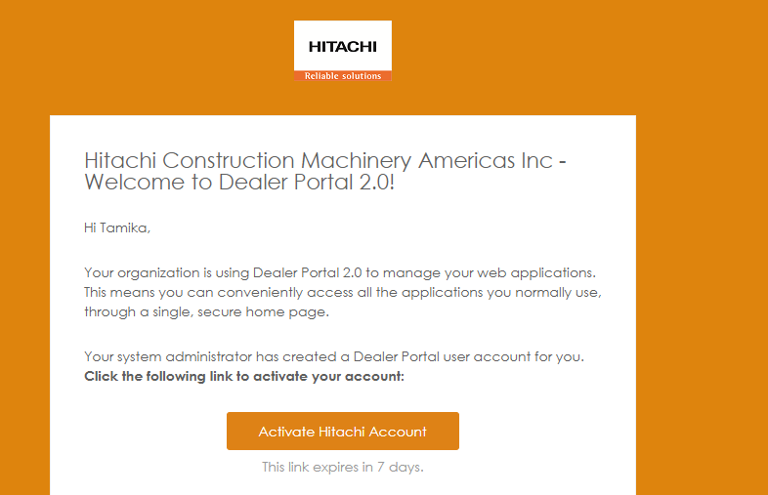
Accessing Dealer Portal 2.0
After you have selected your authentication methods, you will receive an email to verify your account.
Please be aware that if you do not activate this link within 7 days, your account will become deactivated.
To regain access to your account, you will need to email, portalhelp@hitachicm.us
The activation link must be opened with the same browser you are using to sign in with. Otherwise, use the verification code to authenticate your account.

Slide 4
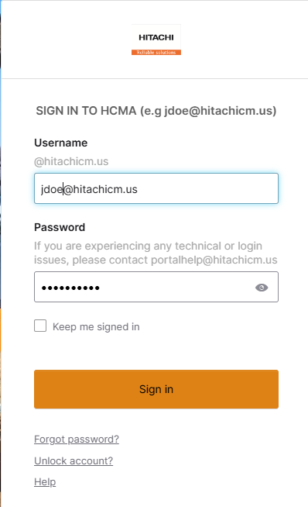
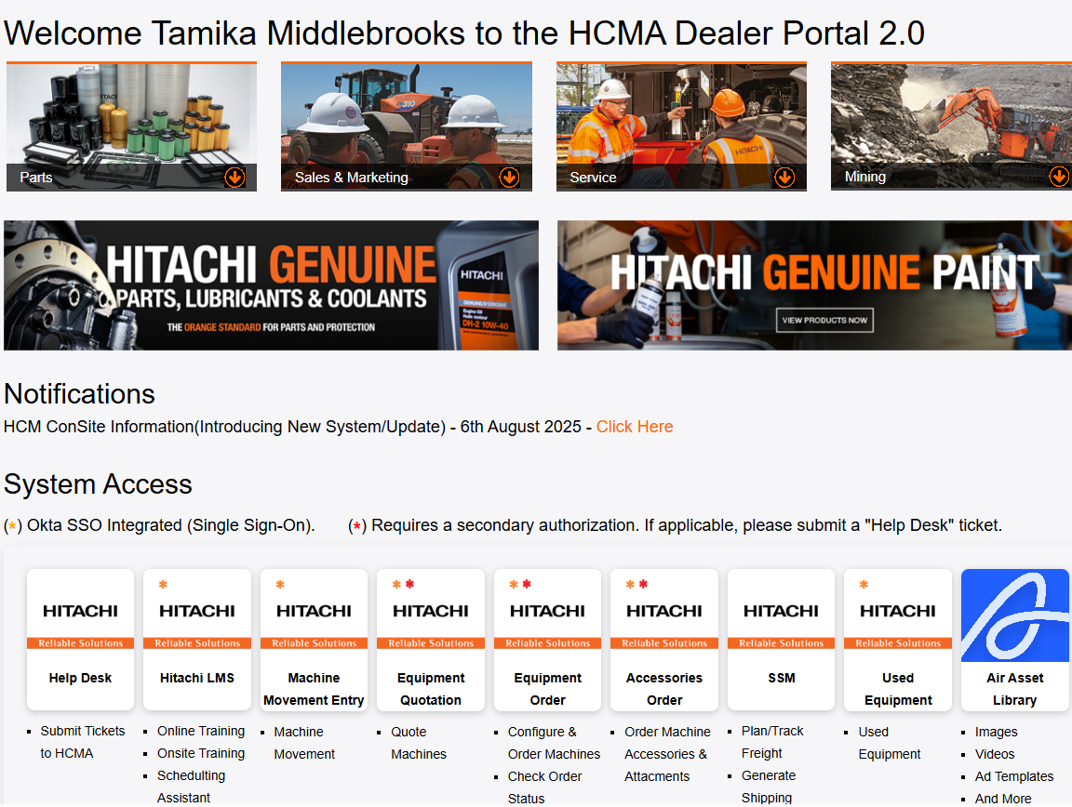
Accessing Dealer Portal 2.0
You are now ready to log in and access the Dealer Portal.
https://dealerportal.hitachicm.us

Slide 5
Account Help To unlock your dealer portal account Initiate the process: On the dealer portal login page, click on the Choose the "Unlock account?" option. Provide identifying information: Enter your email address or username. Follow authentication prompts: You may be asked to answer security questions, Complete verification: Follow the on-screen instructions to verify your identity. Log in: Once your account is unlocked, you can sign in to Okta again. To reset your password Initiate the process: On the dealer portal login page, click on the "Forgot Password?" Provide your username or email: Enter the email address or username associated with your Okta account and click "Reset via Email" or the relevant option. Check your email or phone for verification: You will receive an email or text message with a reset link or code. Verify your identity: Click the "Reset Password" link in the email or enter the code from your SMS. If you're prompted for a security question, provide the answer. Set your new password: On the password reset page, enter your new password and confirm it, then click "Reset Password". **For all other issues, please contact your dealer portal support rep.

